Slide 1
WELCOME
Presenter :
Name : Muhammad Sajjad Amin
ID : 211002081
Department : Computer Science & Engineering
Name : Manik shekh
ID : 211002106
Department : Computer Science & Engineering

Slide 2
Internet controlled switch
control everything even when you are overseas!

Slide 3
What is internet controlled switch?
The internet-controlled switch is a digital switching system where a microcontroller circuit is connected to a local network by Wi-Fi, LAN, or others connectivity mediums. But, Wi-Fi network is commonly used for it. This local network is connected to the public network with a public IP address to access the switch through the internet. The microcontroller unit acts as a server. The end-user sends the switching request using web browser or mobile application and it receives the request and switching the associated relay module by passing the high and low voltage by its digital pin.

Slide 4
Requirements
In this project, we have used the following components.
NodeMCU ESP8266 Wi-Fi microcontroller unit.
Two channel relay module
Wi-Fi Router
Breadboard
Jumper wire (male to female)
Some LED
DC 5 volte power adapter (micro USB port)

Slide 5
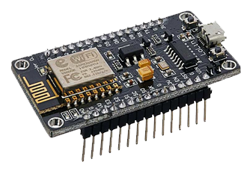
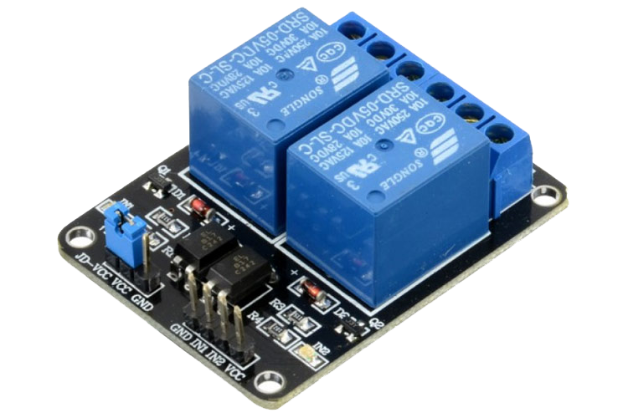
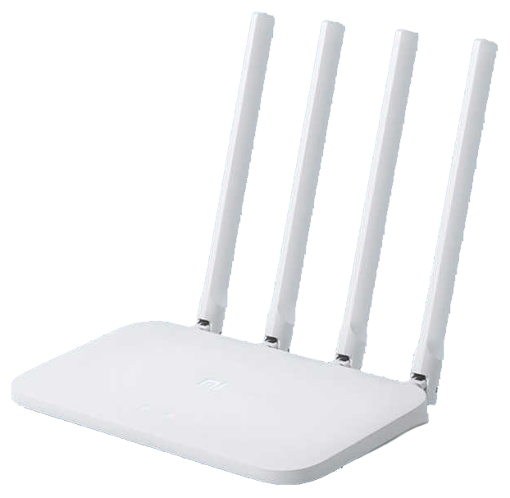
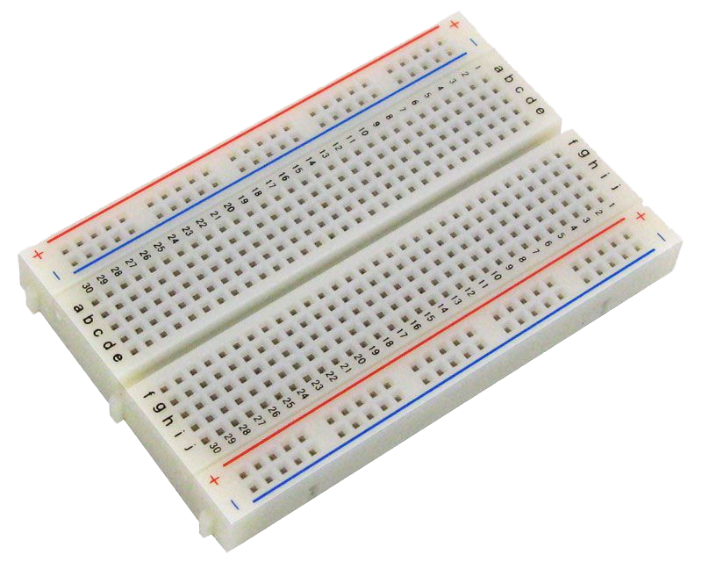
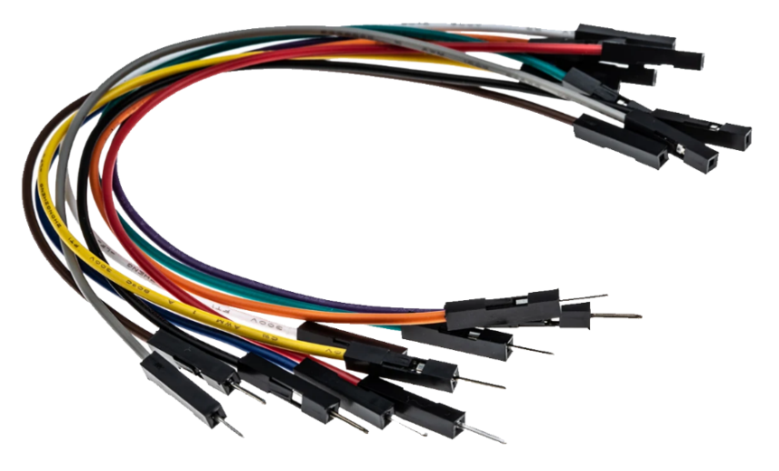
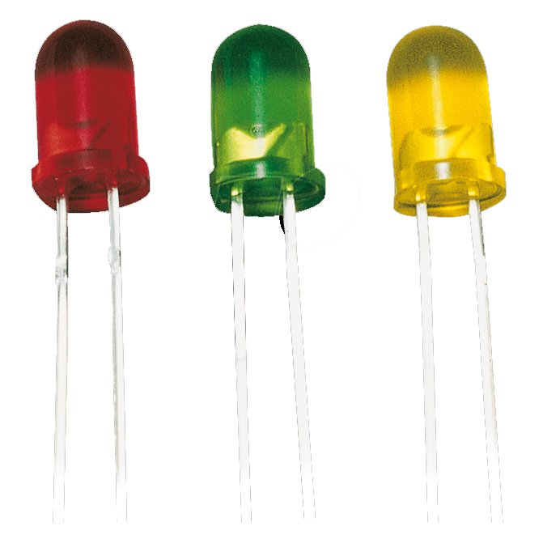
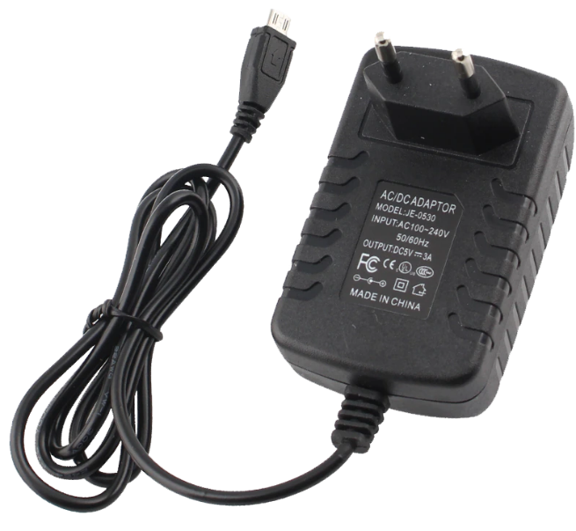
All components at a glance

Slide 6
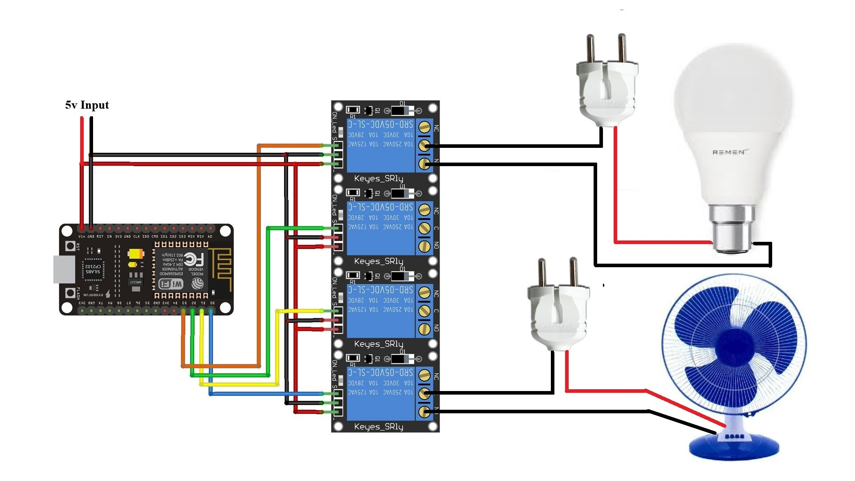
Circuit diagram

Slide 7
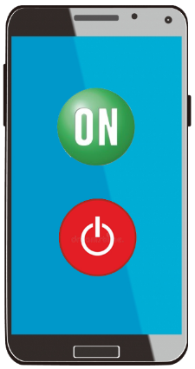

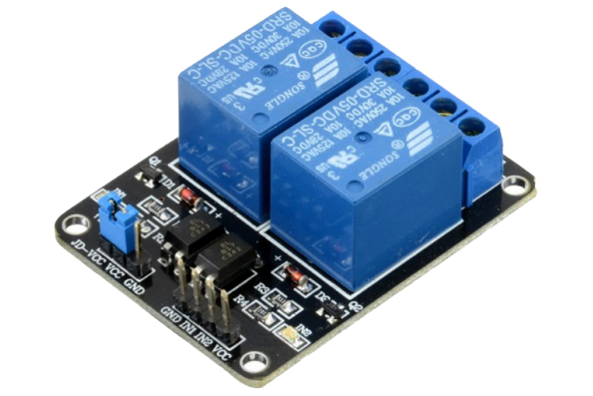

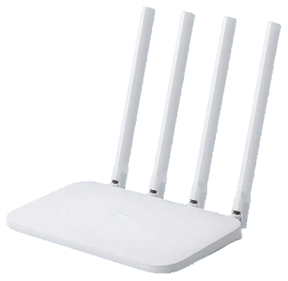
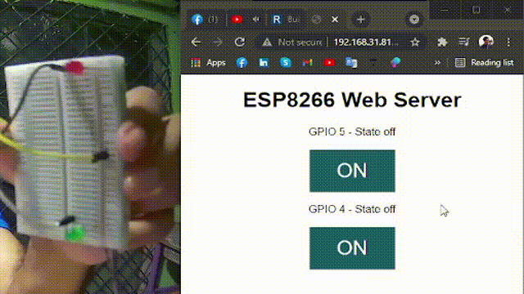
How does it work
0
1
0
1
0
1
220 V
AC

Slide 8
Applications of this project
Though it is a simple project, But it can be used for large-scale infrastructure. It can be used by the following fields.
Home automation
Remote machine management for industries
Internet of things
Unmanned areal vehicle

Slide 9


Some precautionary aspects
Since it uses a network to communicate with users, so hackers can hack the network and take control of the whole system.
Another challenging thing is if you control it for long-distance, you must ensure the internet service for 24 hours. Though it can be used without the internet with the help of a Wi-Fi router via a local network.

Slide 10
Thank You

